Slide 1
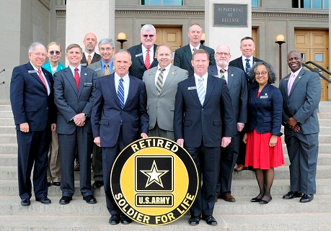
SURVIVOR BENEFIT BRIEFING
RETIREMENT SERVICES INSTALLATION ONLINE Survivor Benefit Briefing
Fort Benning, Georgia
17 MARCH 2020
We are the Army's Home
#LifeisBetteratBenning

Slide 2
Separation briefing
ATTENTION
This presentation is only for Soldiers who are 12 months out from retirement date beginning 23 March 2020. Soldiers 90 days outside 12 month retirement window must physically attend a mandatory briefing once COVID-19 restrictions have ended. Please do not use these slides for soldiers with a retirement date after 10 May 2021. Additional provisions will be made as needed.

Slide 3

SURVIVOR BENEFIT BRIEFING
CHANGE.... MISINFORMATION you may have heard about SBP from UNINFORMED People
INTO..... INFORMATION
From INFORMED Experts
We are the Army's Home
#LifeisBetteratBenning

Slide 4
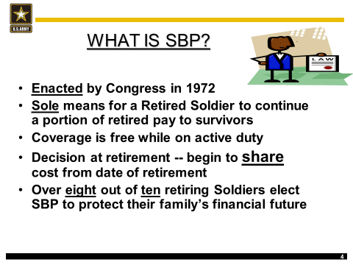
SURVIVOR BENEFIT BRIEFING
We are the Army's Home
#LifeisBetteratBenning

Slide 5
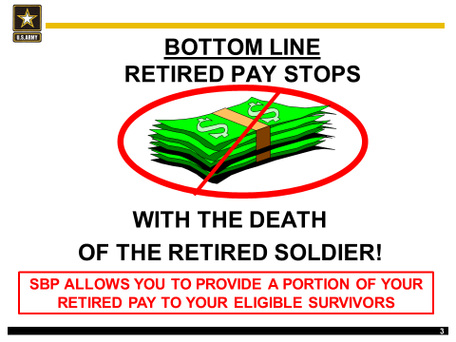
SURVIVOR BENEFIT BRIEFING
We are the Army's Home
#LifeisBetteratBenning

Slide 6
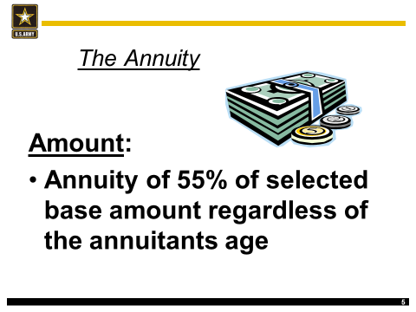
SURVIVOR BENEFIT BRIEFING
We are the Army's Home
#LifeisBetteratBenning

Slide 7
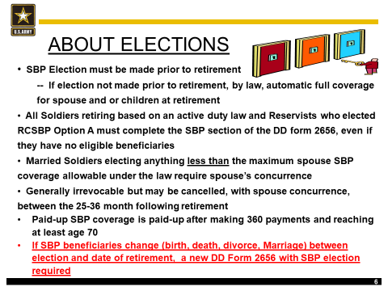
SURVIVOR BENEFIT BRIEFING
We are the Army's Home
#LifeisBetteratBenning

Slide 8
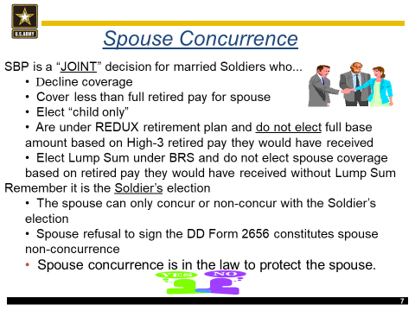
SURVIVOR BENEFIT BRIEFING
We are the Army's Home
#LifeisBetteratBenning

Slide 9
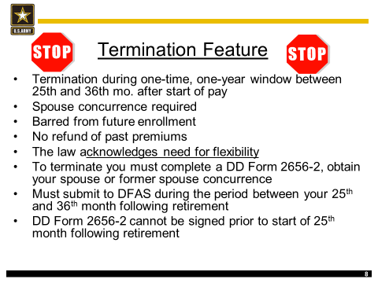
SURVIVOR BENEFIT BRIEFING
We are the Army's Home
#LifeisBetteratBenning

Slide 10
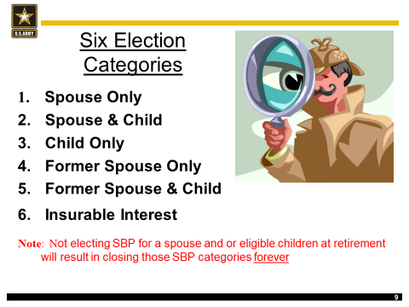
SURVIVOR BENEFIT BRIEFING
We are the Army's Home
#LifeisBetteratBenning

Slide 11
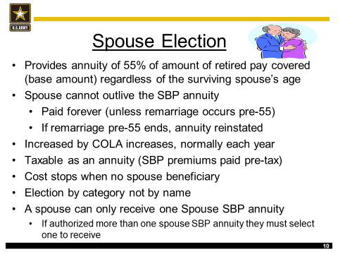
SURVIVOR BENEFIT BRIEFING
We are the Army's Home
#LifeisBetteratBenning

Slide 12
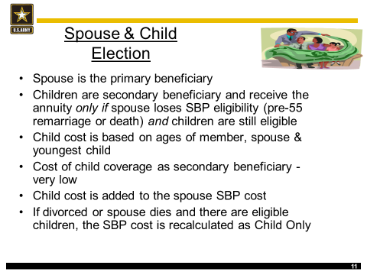
SURVIVOR BENEFIT BRIEFING
We are the Army's Home
#LifeisBetteratBenning

Slide 13
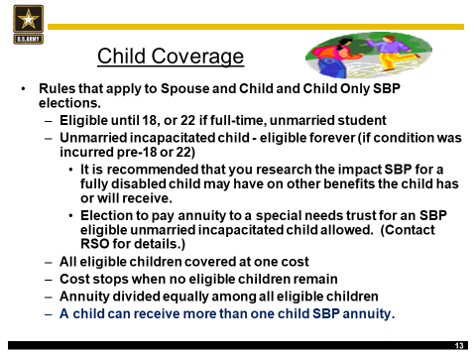
SURVIVOR BENEFIT BRIEFING
We are the Army's Home
#LifeisBetteratBenning

Slide 14
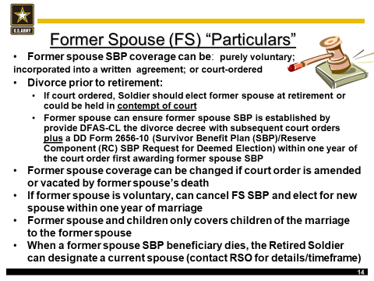
SURVIVOR BENEFIT BRIEFING
We are the Army's Home
#LifeisBetteratBenning

Slide 15
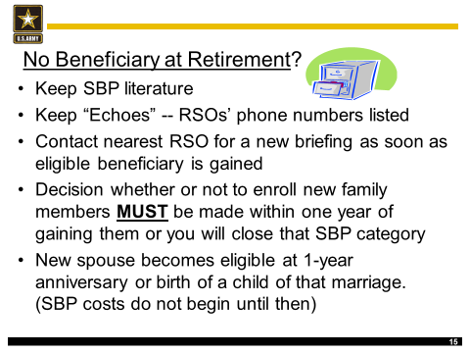
SURVIVOR BENEFIT BRIEFING
We are the Army's Home
#LifeisBetteratBenning

Slide 16
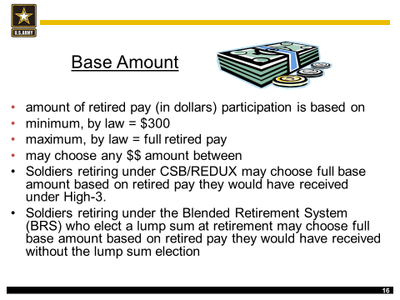
SURVIVOR BENEFIT BRIEFING
We are the Army's Home
#LifeisBetteratBenning

Slide 17
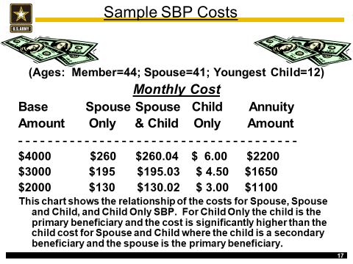
SURVIVOR BENEFIT BRIEFING
We are the Army's Home
#LifeisBetteratBenning

Slide 18
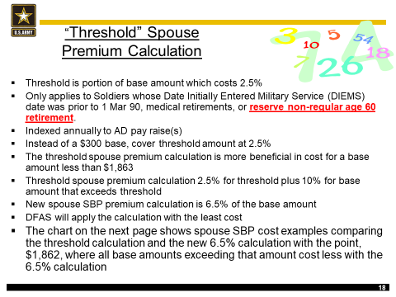
SURVIVOR BENEFIT BRIEFING
We are the Army's Home
#LifeisBetteratBenning

Slide 19
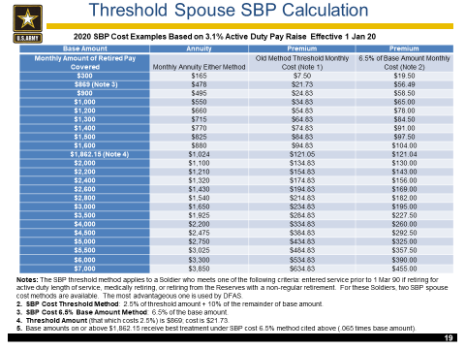
SURVIVOR BENEFIT BRIEFING
We are the Army's Home
#LifeisBetteratBenning

Slide 20
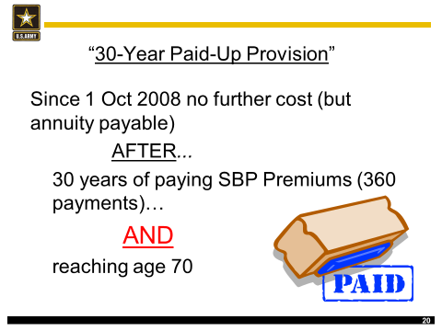
SURVIVOR BENEFIT BRIEFING
We are the Army's Home
#LifeisBetteratBenning

Slide 21
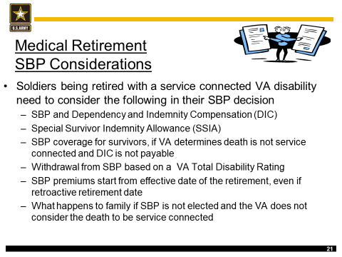
SURVIVOR BENEFIT BRIEFING
We are the Army's Home
#LifeisBetteratBenning

Slide 22
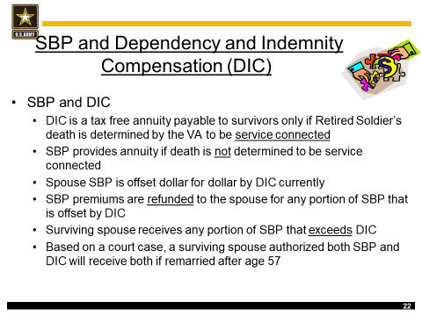
SURVIVOR BENEFIT BRIEFING
We are the Army's Home
#LifeisBetteratBenning

Slide 23
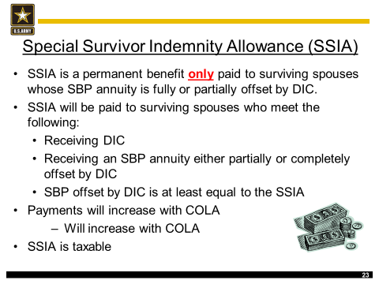
SURVIVOR BENEFIT BRIEFING
We are the Army's Home
#LifeisBetteratBenning

Slide 24
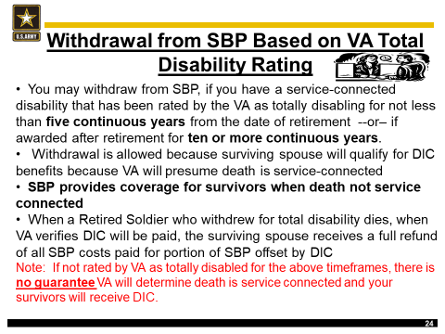
SURVIVOR BENEFIT BRIEFING

Slide 25
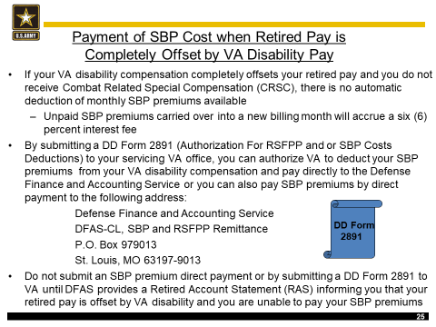
SURVIVOR BENEFIT BRIEFING

Slide 26
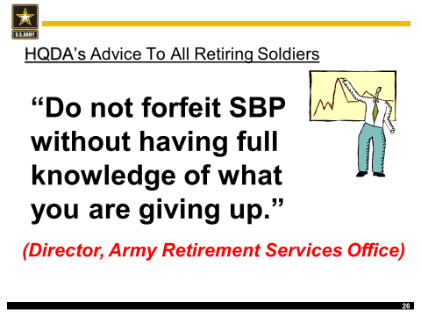
SURVIVOR BENEFIT BRIEFING

Slide 27
SURVIVOR BENEFIT BRIEFING
Retirement Services Office (RSO), Point of Contact
Retirement Services Officer: Mrs. Clemons - 545-1805
Alternate RSO: Mrs. Colson – 545-4434
SBP Counselor: Ms. Harris – 545-2715
Analyst Clerk: Mrs. Marshall – 545-1738
Analyst Clerk: Ms. Jenkins – 545-1828
For more SBP Information log on to:
http://soldierforlife.army.mil/retirement/
http://myarmybenefits.us.army.mil/

Slide 28

SURVIVOR BENEFIT BRIEFING
I have viewed Survivor Benefit Plan slides
PRINT NAME:________________________________
SIGNATURE: ________________________________
DATE: ______________________________________
Please print signature page and email to: usarmy.benning.imcom.mbx.glhrd-rso@mail.mil

